Slide 1
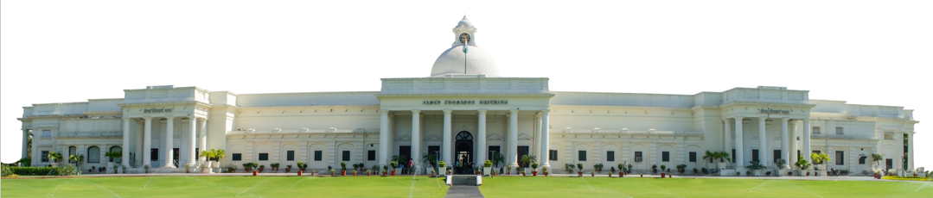
Predictive Maintenance & Failure-Mode Analysis
Summer Internship- 2026
Name: Varsha Sangwan
Supervisor: Prof. Millie Pant
Mentor: Ms. Riya & Mr. Harjeet Singh Applied Mathematics & Scientific Computing
Indian Institute of Technology Roorkee

Slide 2

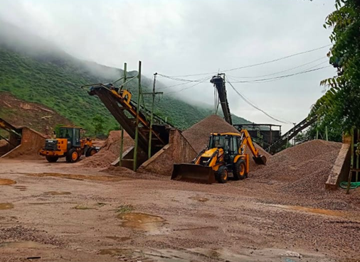
Why Predictive Maintenance Matters
Charkhi Dadri and the wider Haryana Aravali belt host dozens of stone-crushing and mining units — heavy rotating machinery running continuously under dust, vibration and load.
In such plants, an unplanned crusher or conveyor breakdown halts the entire production line — costing far more than routine servicing ever would.
This project builds a machine-learning system that predicts failure before it happens and diagnoses which failure mechanism is responsible — a methodology directly transferable to crusher, mill and conveyor equipment.
Because plant-specific sensor logs are rarely public, the model is built and validated on the AI4I 2020 industrial milling-machine dataset — a widely used benchmark with the same core sensor variables (temperature, torque, rotational speed, tool wear).
1

Slide 3
Agenda
01
Methodology Pipeline
06
Handling Class Imbalance
02
Dataset Overview
07
Model Development & Comparison
03
Exploratory Data Analysis
08
Multi-Class Failure Diagnosis
04
Failure Mode Analysis
09
Conclusion & Recommendations
05
Preprocessing & Feature Engineering
10
References
2

Slide 4
End-to-End Methodology Pipeline
Data
Collection
EDA
Failure Mode
Analysis
Preprocessing &
Feature Eng.
Imbalance
Handling
Model
Training
Evaluation &
Comparison
Multi-Class
Diagnosis
Tooling
Python · pandas / NumPy · scikit-learn · imbalanced-learn · SDV (CTGAN / TVAE) · matplotlib / seaborn
3

Slide 5
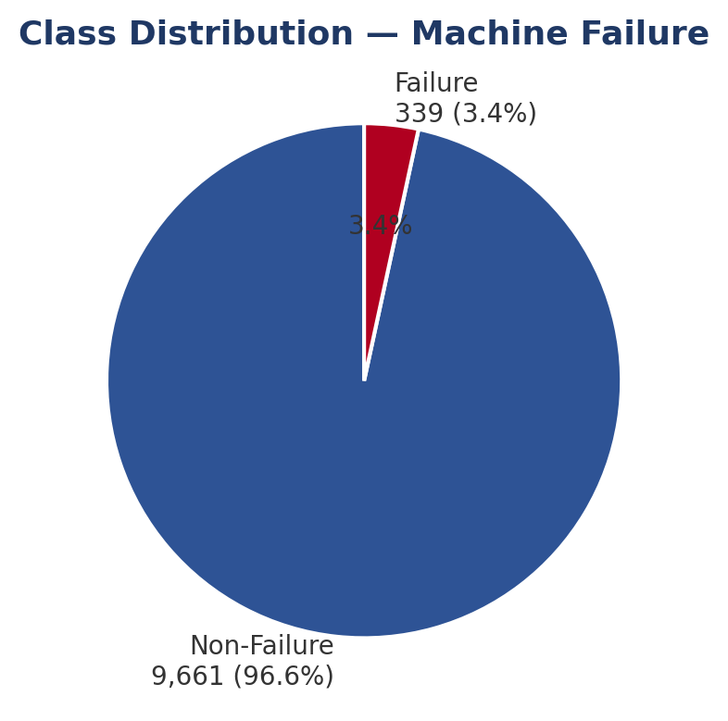
Dataset Overview
Attribute | Detail
Source | UCI ML Repository — AI4I 2020 Predictive Maintenance Dataset
Size | 10,000 records × 14 columns, no missing values
Target | Machine failure (binary) — 339 failures / 9,661 non-failures (3.39%)
Core Sensors | Air Temp, Process Temp, Rotational Speed, Torque, Tool Wear
Product Variant | Quality grade L / M / H (proxy for build quality, ~50% / 30% / 20%)
Failure Modes | TWF, HDF, PWF, OSF, RNF — 5 independent physical mechanisms
4

Slide 6
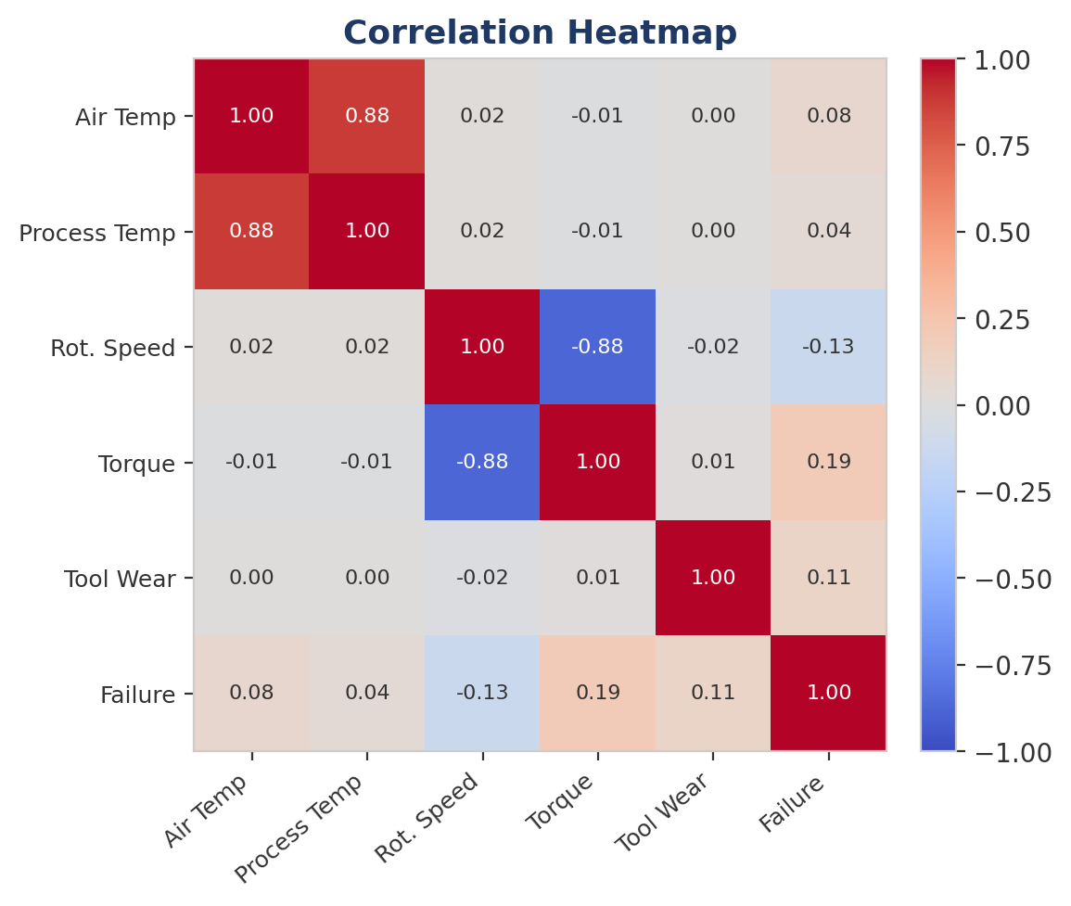
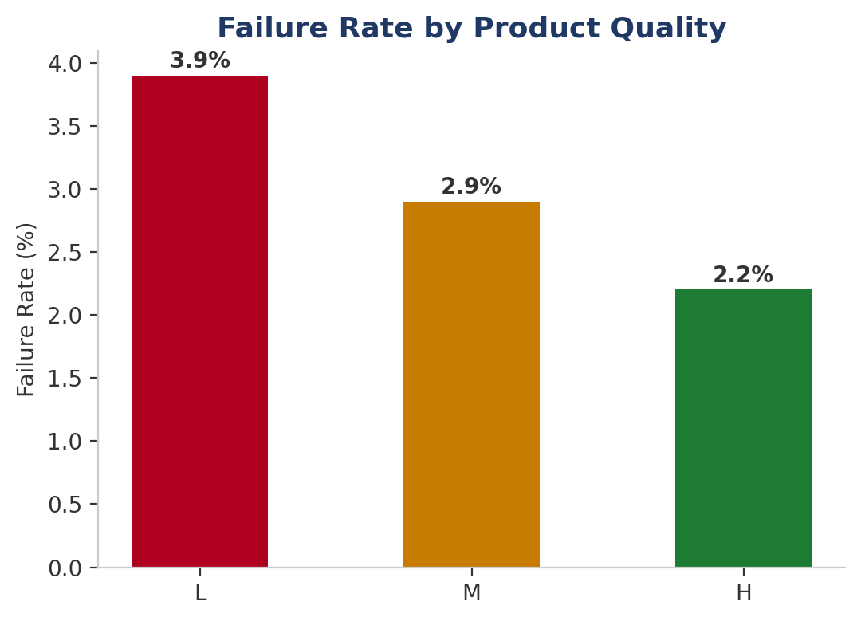
Exploratory Data Analysis
Torque and Tool Wear show the strongest correlation with failure — directly reflecting their role in the OSF and TWF rule definitions. Low-quality (L) parts fail more often than High-quality (H) parts.
5

Slide 7
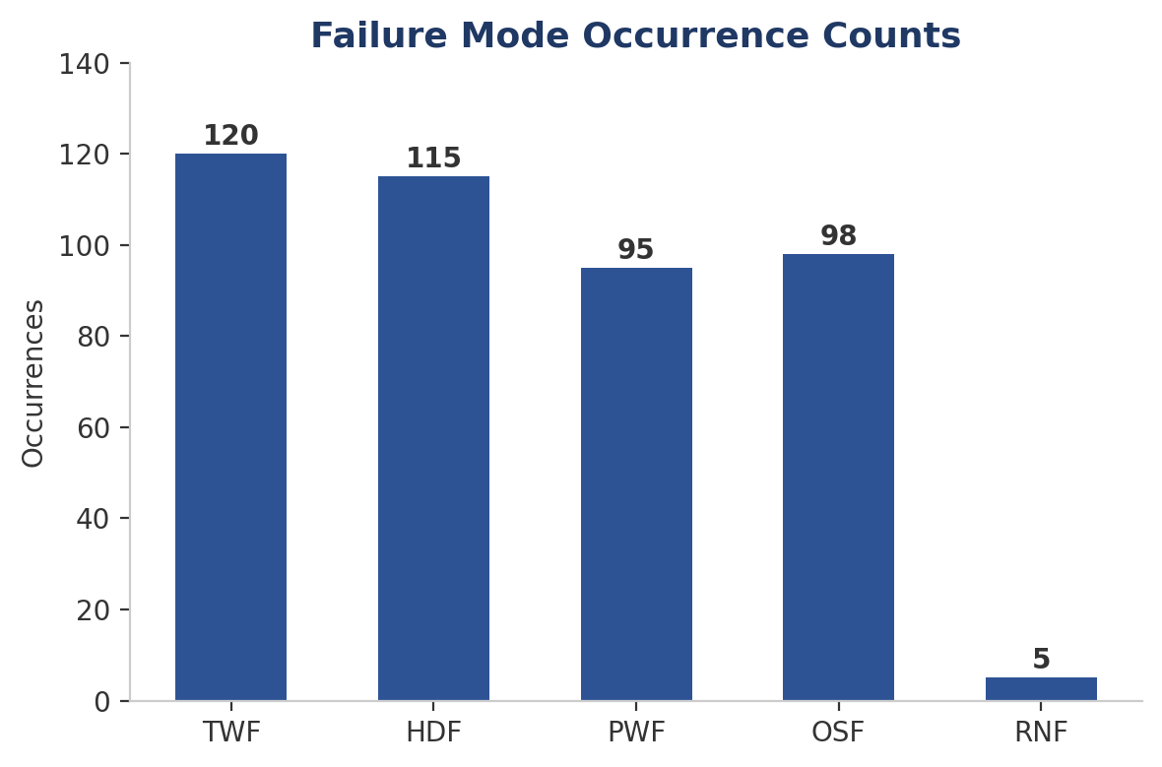
Failure Mode Analysis
Mode | Trigger Rule
TWF | Tool wear 200–240 min
HDF | ΔTemp < 8.6K & speed < 1,380 rpm
PWF | Power < 3,500W or > 9,000W
OSF | Wear × Torque exceeds L/M/H threshold
RNF | 0.1% random chance
Most frequent: TWF (Tool Wear Failure), 120 occurrences. Some records trigger more than one mode simultaneously — high wear combined with high torque can jointly cause TWF and OSF.
6

Slide 8
Preprocessing & Feature Engineering
Cleaning
Encoding & Scaling
Engineered Features
Removed duplicate records
Dropped UID identifier column
Confirmed zero missing values
Product Quality (L/M/H) → 0/1/2
StandardScaler on all numeric features
75% / 25% stratified train-test split
Power = Torque × Rot. Speed (rad/s)
Temp Diff = Process Temp − Air Temp
Wear × Torque (for OSF detection)
7

Slide 9
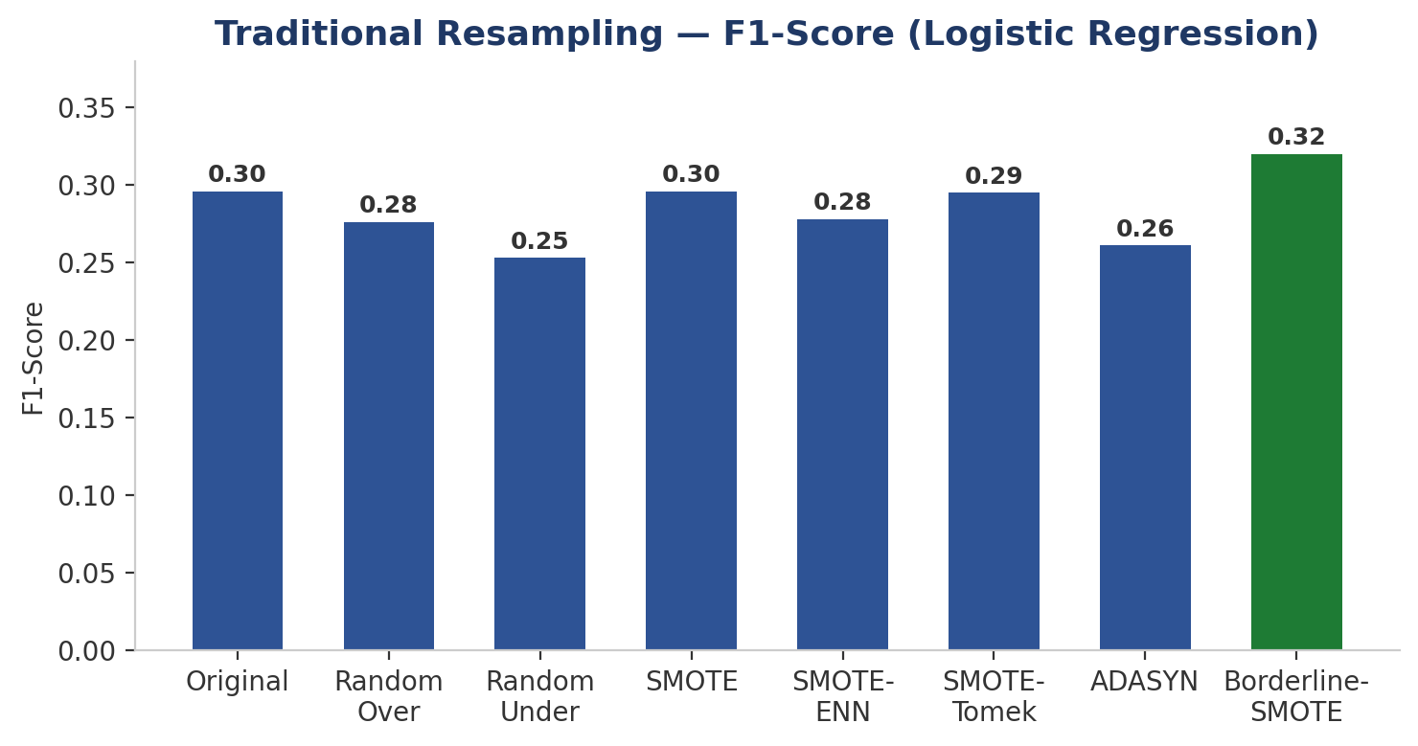
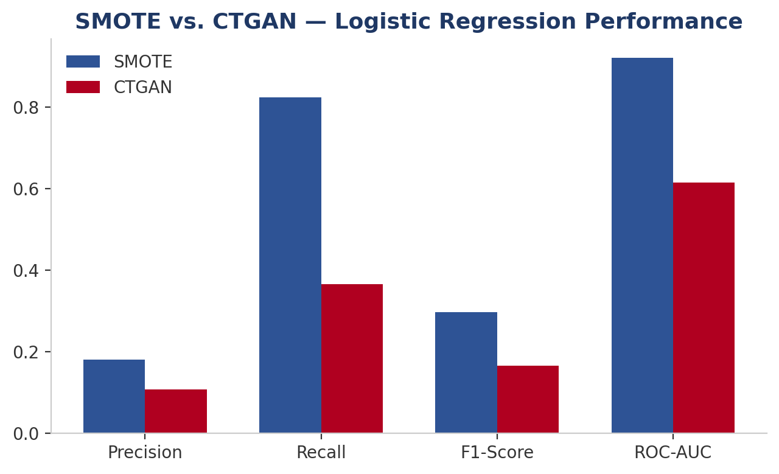
Handling Class Imbalance
Borderline-SMOTE gave the best traditional F1 (0.320). CTGAN underperformed SMOTE on every metric — only 254 real failure examples were too few to train a reliable generative model.
8

Slide 10
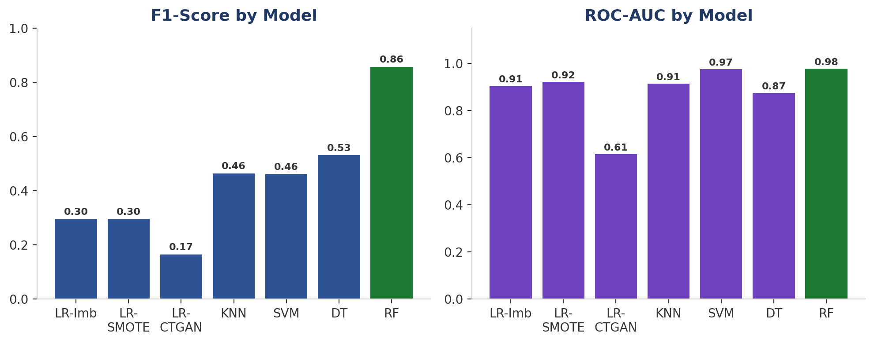
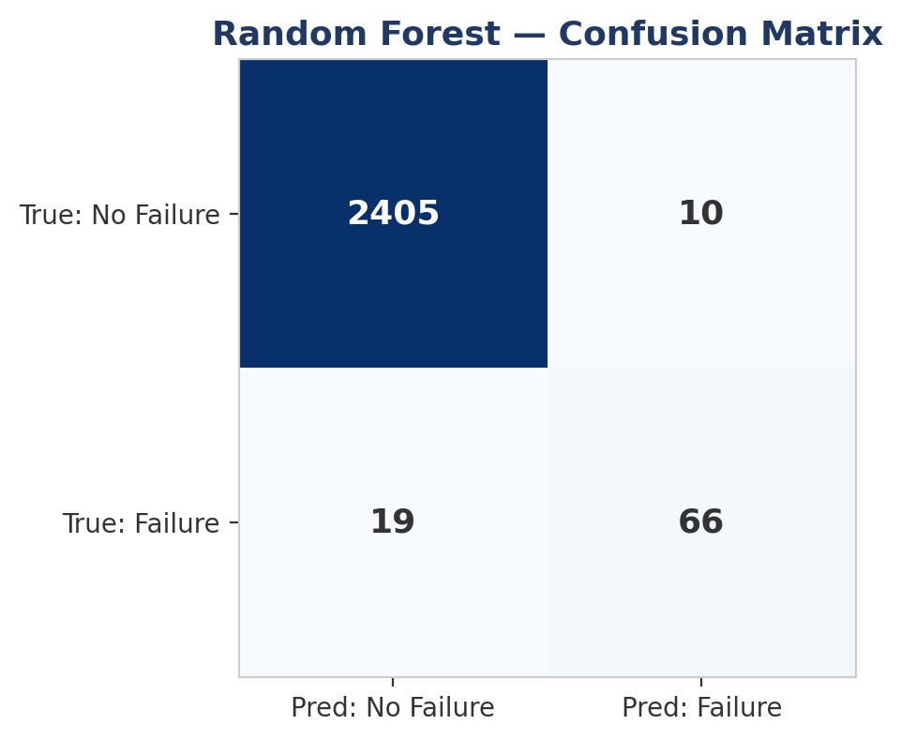
Model Development & Comparison
Model | F1 | ROC-AUC | PR-AUC
Logistic Regression (SMOTE) | 29.6% | 0.922 | 0.375
KNN (SMOTE) | 46.4% | 0.914 | 0.550
SVM (SMOTE) | 46.1% | 0.975 | 0.660
Decision Tree (weighted) | 53.1% | 0.874 | 0.802
Random Forest (weighted) | 85.7% | 0.978 | 0.863
Random Forest wins on every metric simultaneously — no Precision/Recall trade-off, and no synthetic data required.
9

Slide 11
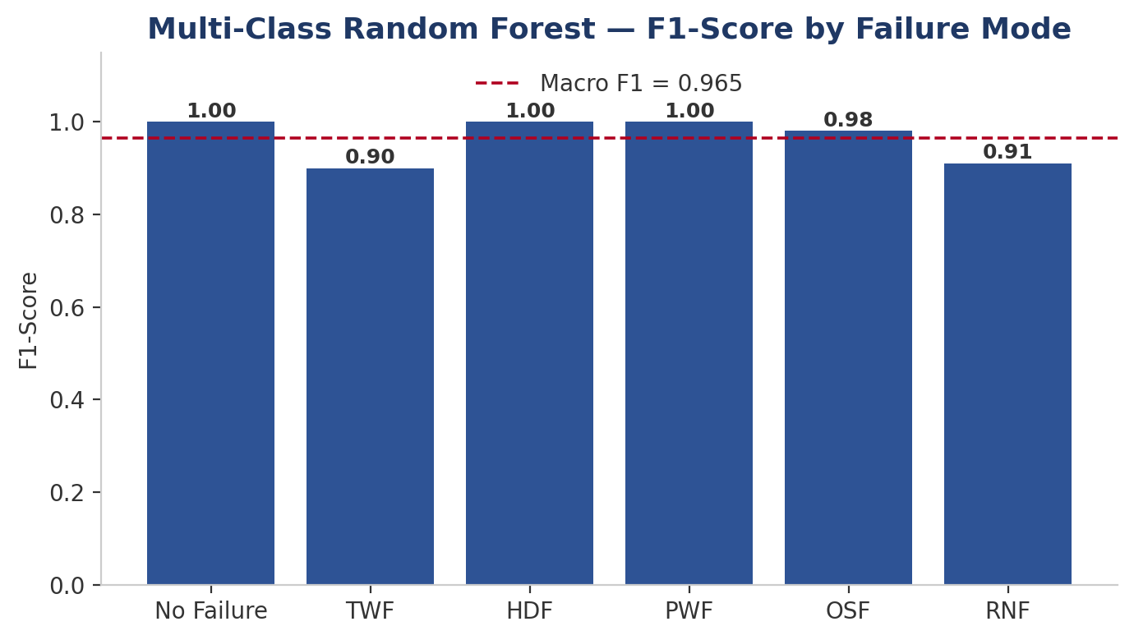
Multi-Class Failure Diagnosis
6-Class Random Forest
(SMOTE-balanced)
96.5%
Macro F1-Score
99.8%
Weighted F1-Score
Diagnoses which of the 5 failure mechanisms is responsible — not just that a failure occurred.
10

Slide 12
Conclusion & Recommendations
Key Findings
Recommendations
Random Forest (class-weighted) is the strongest model — F1 = 85.7%, ROC-AUC = 0.978 and PR-AUC = 0.863
Borderline-SMOTE beat CTGAN for this dataset's small minority-class size.
Multi-class diagnosis reaches 96.5% Macro-F1 — failure modes are highly distinguishable once balanced.
Deploy the class-weighted Random Forest as the primary failure detector — no synthetic data pipeline needed.
Extend to multi-class output so maintenance crews get an actionable diagnosis (TWF/HDF/PWF/OSF/RNF).
Applicable directly to crusher and conveyor fleets — monitor Torque, Tool Wear and Temperature Difference closely.
11

Slide 13
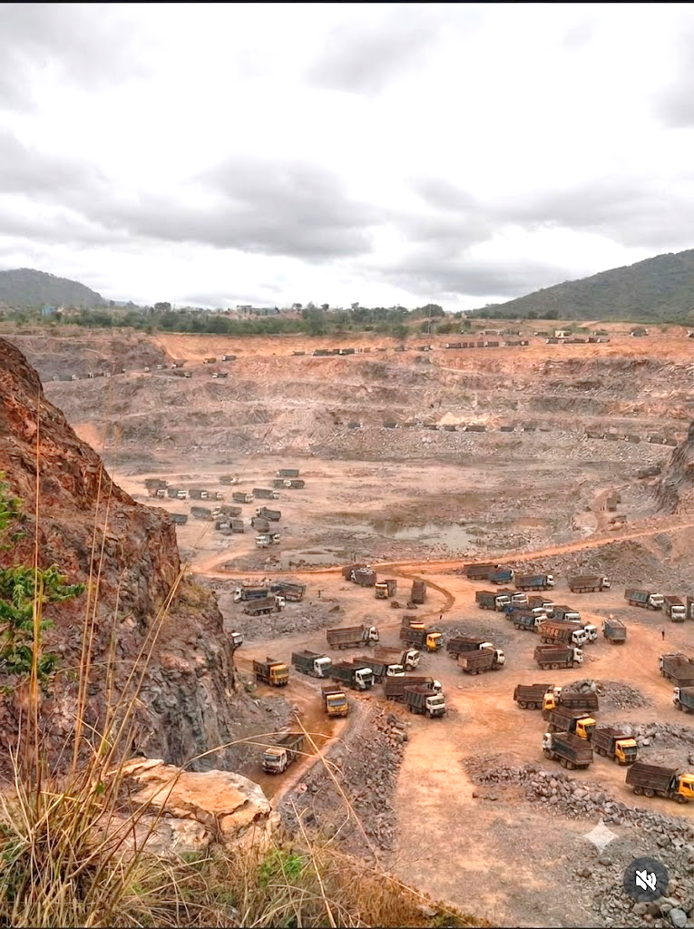
References
AI4I 2020 Predictive Maintenance Dataset — UCI Machine Learning Repository.
scikit-learn documentation — Logistic Regression, KNN, SVM, Decision Tree, Random Forest.
imbalanced-learn (imblearn) documentation — SMOTE, ADASYN, SMOTE-ENN, SMOTE-Tomek, Borderline-SMOTE.
SDV / CTGAN — Synthetic Data Vault library for tabular generative modeling.
13

Slide 14
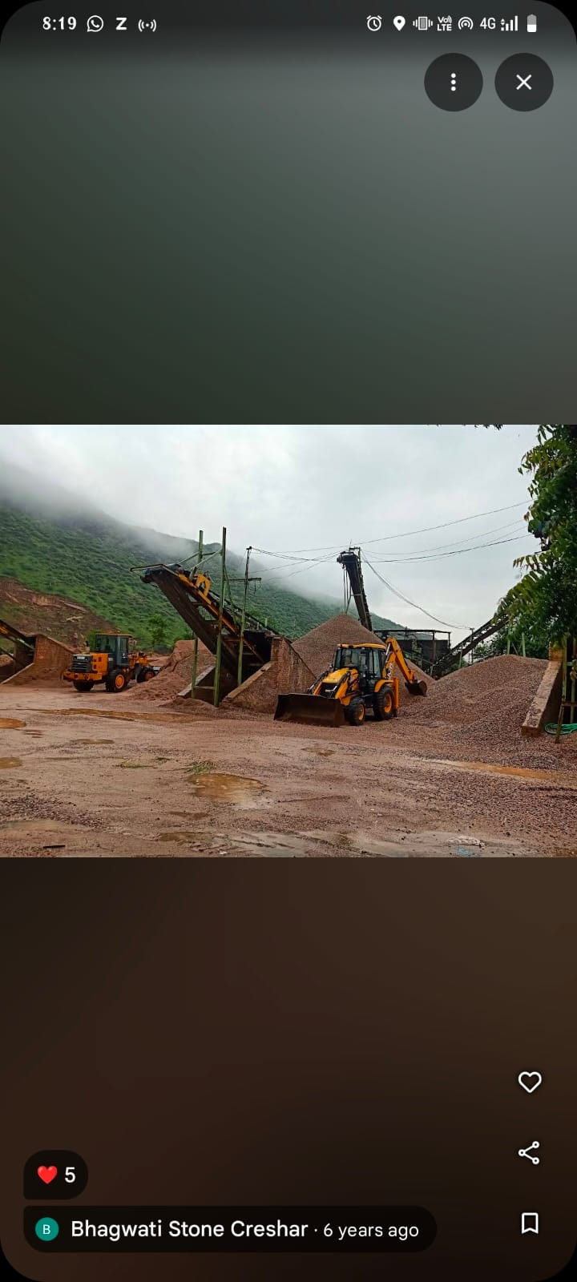
THANK YOU
14

